Slide 1
“THEORY OF AUTOMATA”
A new format for FAs

Slide 2
Summary
Turing machine, examples, DELETE subprogram, example, INSERT subprogram, example.

Slide 3
Turing machine
The mathematical models (FAs, TGs, PDAs) that have been discussed so far can decide whether a string is accepted or not by them i.e. these models are language identifiers. However, there are still some languages which can’t be accepted by them e.g. there does not exist any FA or TG or PDA accepting any non-CFLs.
Alan Mathison Turing developed the machines called Turing machines, which accept some non-CFLs as well, in addition to CFLs.

Slide 4


Definition
A Turing machine (TM) consists of the following
An alphabet A of input letters.
An input TAPE partitioned into cells, having infinite many locations in one direction. The input string is placed on the TAPE starting its first letter on the cell i, the rest of the TAPE is initially filled with blanks (D’s).
A tape Head can read the contents of cell on the TAPE in one step. It can replace the character at any cell and
can reposition itself to the next cell to the right or to the left of that it has just read. Initially the TAPE Head is at
the cell i. The TAPE Head can’t move to the left of cell i. the location of the TAPE Head is denoted by

Slide 5
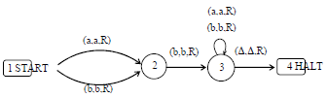

Example
Consider the following Turing machine
Let the input string aba be run over this TM

Slide 6



Starting from the START state, reading a form the TAPE and according to the TM program, a will be printed i.e. a will be replaced by a and the TAPE Head will be moved one cell to the right.
Which can be seen as
This process can be expressed as
At state 2 reading b, state 3 is entered and the letter b is replaced by b, i.e.

Slide 7

At state 3 reading a, will keep the state of the TM unchanged. Lastly, the blank D is read and D is replaced by D and the HALT state is entered. Which can be expressed as
Which shows that the string aba is accepted by this machine. It can be observed, from the program of the TM,
that the machine accepts the language expressed by (a+b)b(a+b)*.

Slide 8
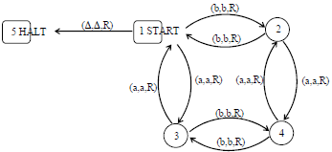
Theorem
Every regular language is accepted by some TM.
Example

Slide 9
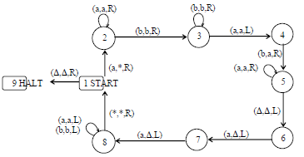
Example
Consider the following TM
The string aaabbbaaa can be observed to be accepted by the above TM. It can also be observed that the above TM accepts the non-CFL {a^{n}b^{n}a^{n}}.

Slide 10
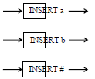
INSERT subprogram
Sometimes, a character is required to be inserted on the TAPE exactly at the spot where the TAPE Head is pointing, so that the character occupies the required cell and the other characters on the TAPE are moved one cell right. The characters to the left of the pointed cell are also required to remain as such.
In the situation stated above, the part of TM program that executes the process of insertion does not affect the function that the TM is performing. The subprogram of insertion is independent and can be incorporated at any time with any TM program specifying what character to be inserted at what location.
The subprogram of insertion can be expressed as

Slide 11




Example
If the letter b is inserted at the cell where the TAPE Head is pointing as shown below
then, it is expressed as
The function of subprogram INSERT b can be observed from the following diagram

Slide 12
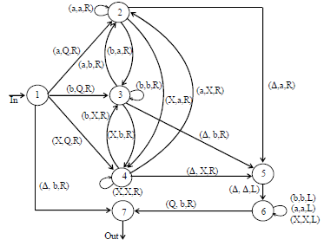
The subprogram INSERT
Keeping in view the same example of inserting b at specified location, to determine the required subprogram, first Q will be inserted as marker at the required location, so that the TAPE Head must be able to locate the proper cell to the right of the insertion cell. The whole subprogram INSERT is given as

Slide 13

It is supposed that machine is at state 1, when b is to be inserted. All three possibilities of reading a, b or X are considered by introducing the states 2,3 and 4 respectively. These states remember what letter displaced during the insertion of Q.
Consider the same location where b is to be inserted

Slide 14

After reading a from the TAPE, the program replaces a by Q and the TAPE Head will be moved one step right.
Here the state 2 is entered. Reading b at state 2, b will be replaced by a and state 3 will be entered. At state 3, b is read which is not replaced by any character and the state 3 will not be left.
At state 3, the next letter to be read is X, which will be replaced by b and the state 4 will be entered. At state 4, ∆ will be read, which will be replaced by X and state 5 will be entered. At state 5, ∆ will be read and without any change state 6 will be entered, while TAPE Head will be moved one step left. The state 6 makes no change whatever (except Q) is read at that state. However at each step, the TAPE Head is moved one step left. Finally, Q is read which is replaced by b and the TAPE Head is moved to one step right.
Hence, the required situation of the TAPE can be shown as

Slide 15

DELETE subprogram
Sometimes, a character is required to be DELETED on the TAPE exactly at the spot where the TAPE Head is pointing, so that the other characters on the right of the TAPE Head are moved one cell left. The characters to the left of the pointed cell are also required to remain as such.
In the situation stated above, the part of TM program that executes the process of deletion does not affect the function that the TM is performing. The subprogram of deletion is independent and can be incorporated at any time with any TM program specifying what character to be deleted at what location. The subprogram of deletion can be expressed as
If the letter a is to be deleted from the string bcabbc, shown below

Slide 16

then, it is expressed as

Slide 17
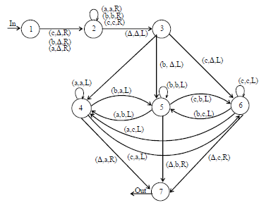
Following is the DELETE subprogram

Slide 18

The process of deletion of letter a from the string bcabbc can easily be checked, giving the TAPE situation as shown below

Slide 19
LINK
www.math.uaa.alaska.edu/~afkjm/cs351/handouts/pda.pdf
www.teco.edu/locationws/18.pdf

